Slide 1
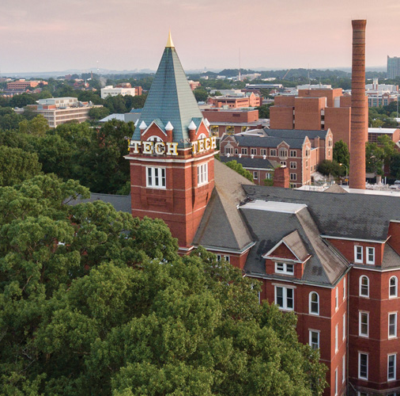

Water Quality
Division B/C
Georgia Tech Event Workshop Series 2025-26

Slide 2
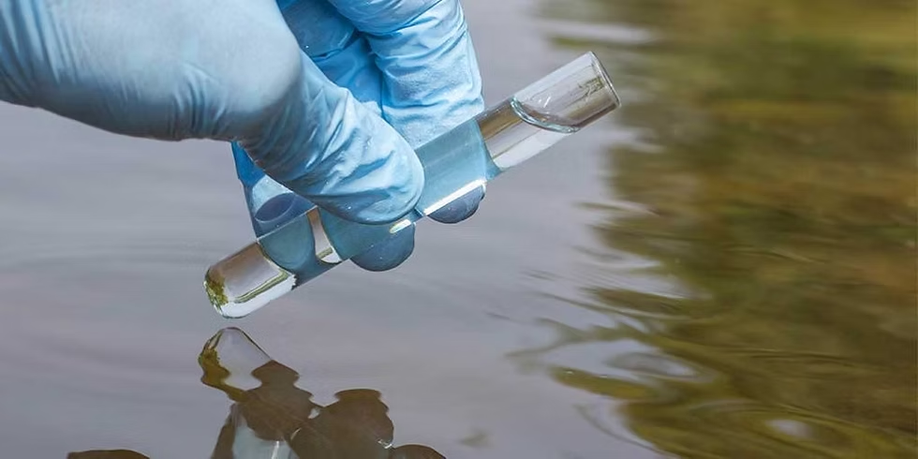
01
RULES SHEET
02
DIFFICULT TOPICS
03
COMMON QUESTIONS
04
TIPS FROM A VETERAN
05
OTHER FREE RESOURCES

Slide 3
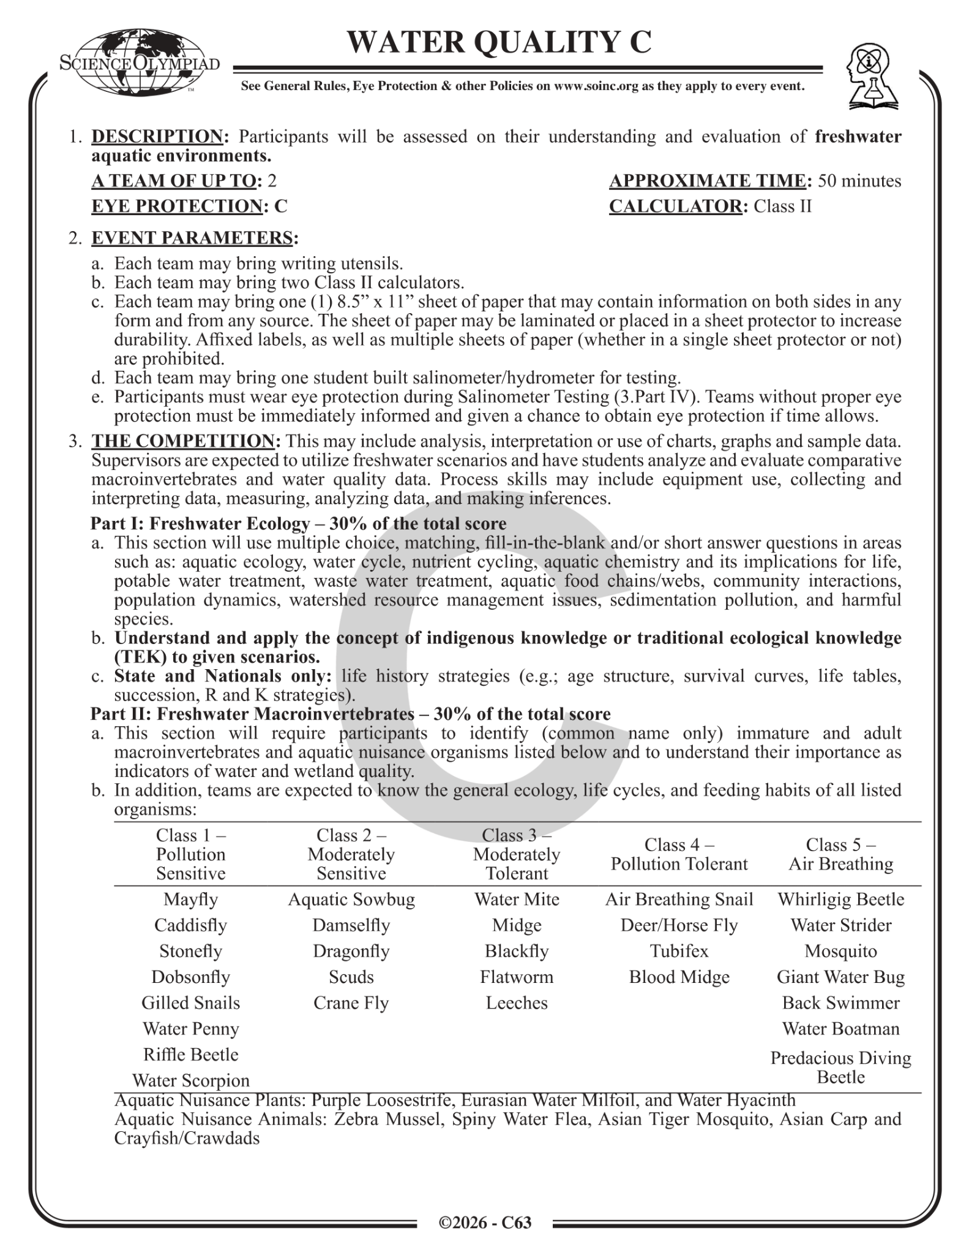
The Rules Sheet
Rules Sheet for Event
Team Size: Up to 2 students
Event Time: ~50 minutes
Materials Allowed:
Writing utensils
Up to 2 Class II calculators
Reference Sheet:
One 8.5″ × 11″ sheet
Both sides allowed
Any format, any source
Event Sections:
Freshwater Ecology — 30%
Macroinvertebrates — 30%
Water Monitoring & Analysis — 30%
Salinometer Testing — 10%
Safety: Eye protection required for salinometer testing

Slide 4

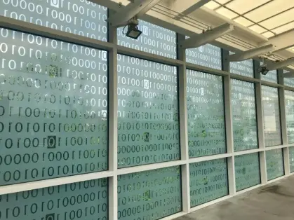
DIFFICULT TOPICS

Slide 5
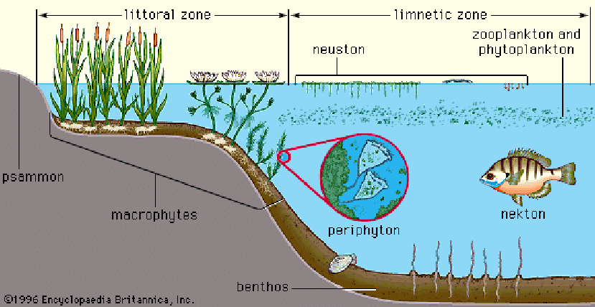
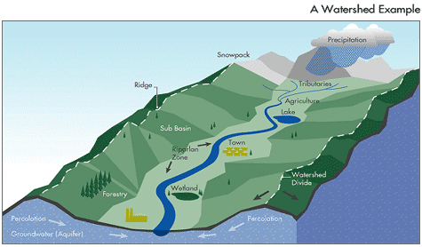
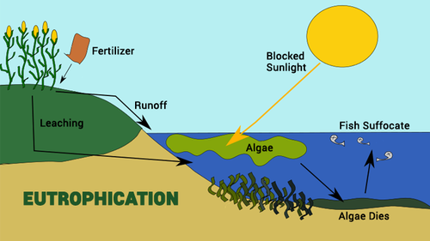
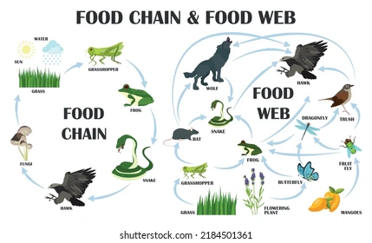
Freshwater Ecology
Aquatic ecosystems & watersheds
Nutrient cycles (Nitrogen & Phosphorus)
Biotic & abiotic factors
Human impacts & pollution
Indicator species & ecosystem health

Slide 6
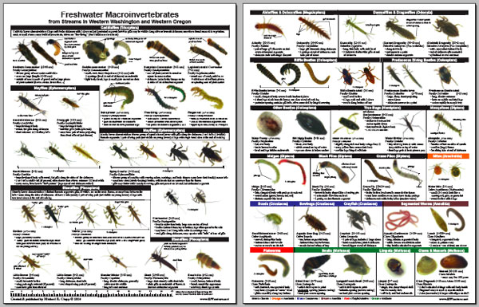
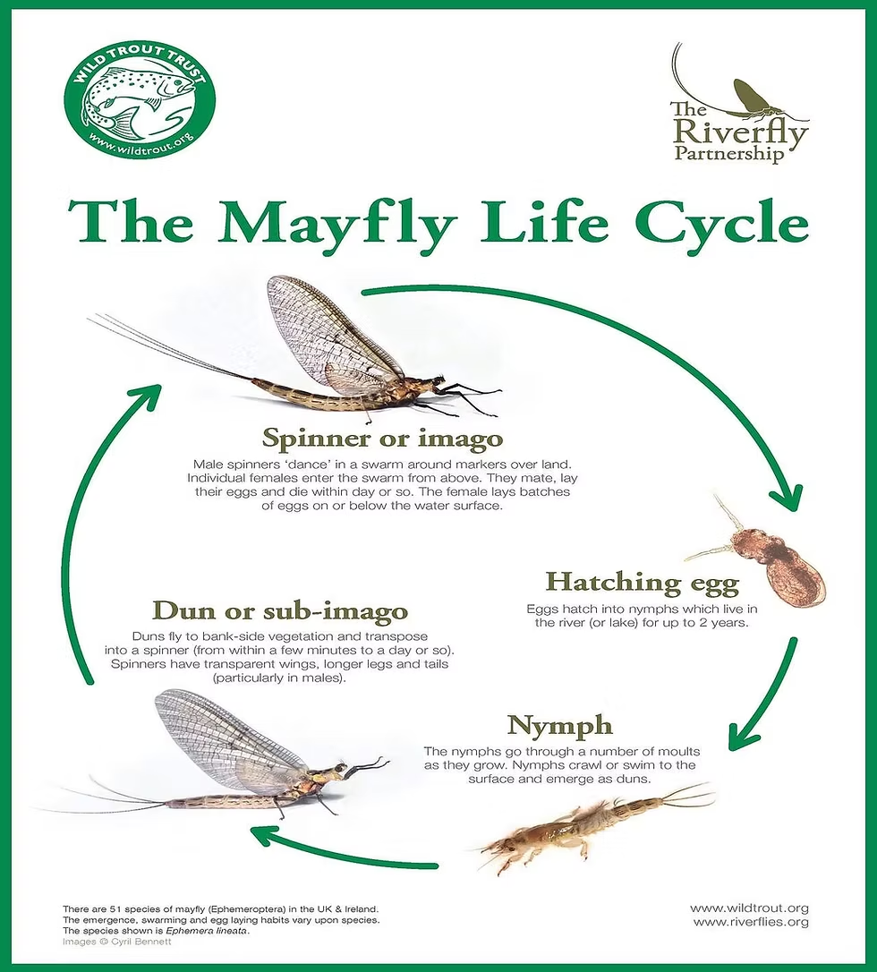
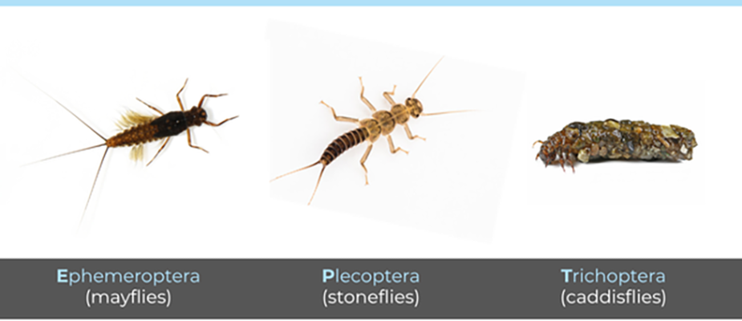
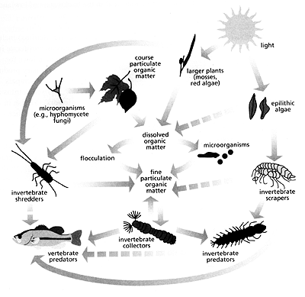
Freshwater macroinvertebrates
What are macroinvertebrates?
Pollution tolerance levels
Indicator species & water quality
Life cycles & feeding groups
Commonly tested taxa

Slide 7
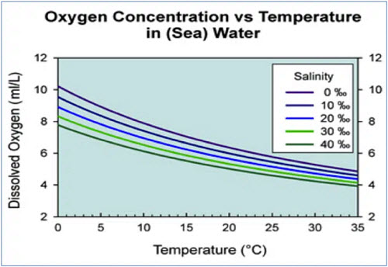
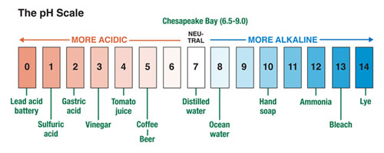
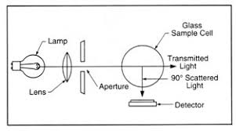
Water monitoring and Analysis
Physical, chemical & biological parameters
pH & dissolved oxygen (DO)
Turbidity & temperature
Nutrients: nitrates & phosphates
Interpreting data & trends

Slide 8


COMMON QUESTIONS
All of the following questions have been pulled from past YJI exams (which can be found on our website) or the Text Exchange on SciOly Wiki
Notes:
\

Slide 9
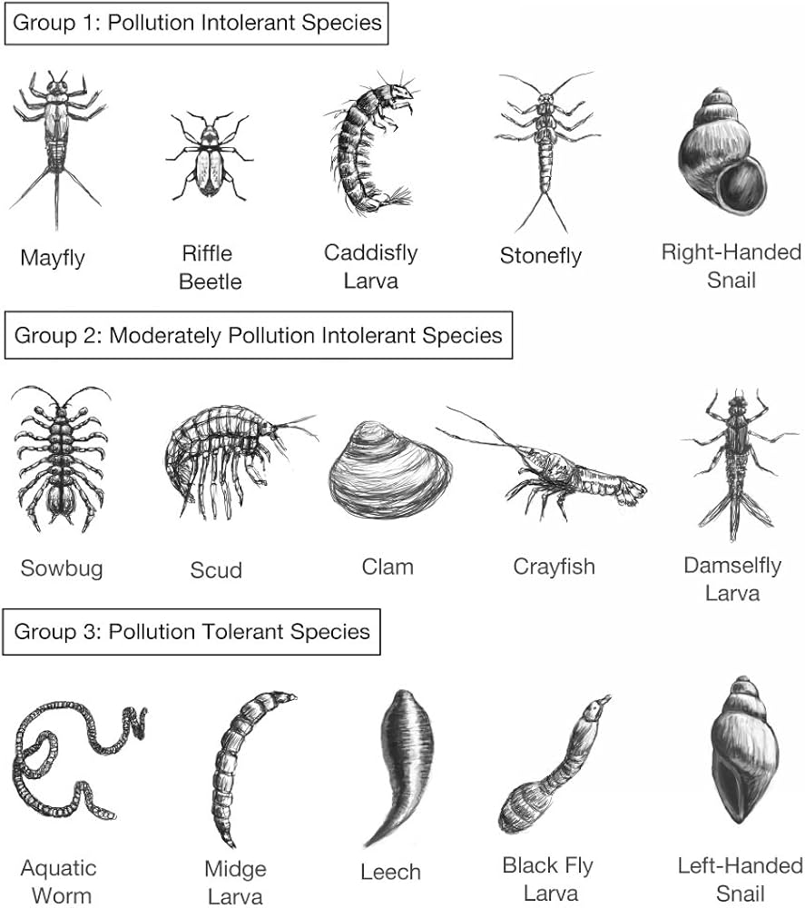
Question 1
Which organism below is the best indicator of high water quality in a freshwater stream?
A. Tubifex worm B. Midge larva C. Mayfly nymph D. Leech

Slide 10
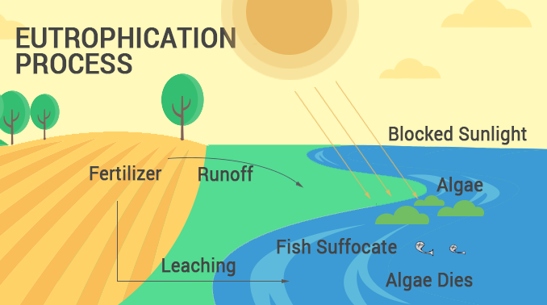
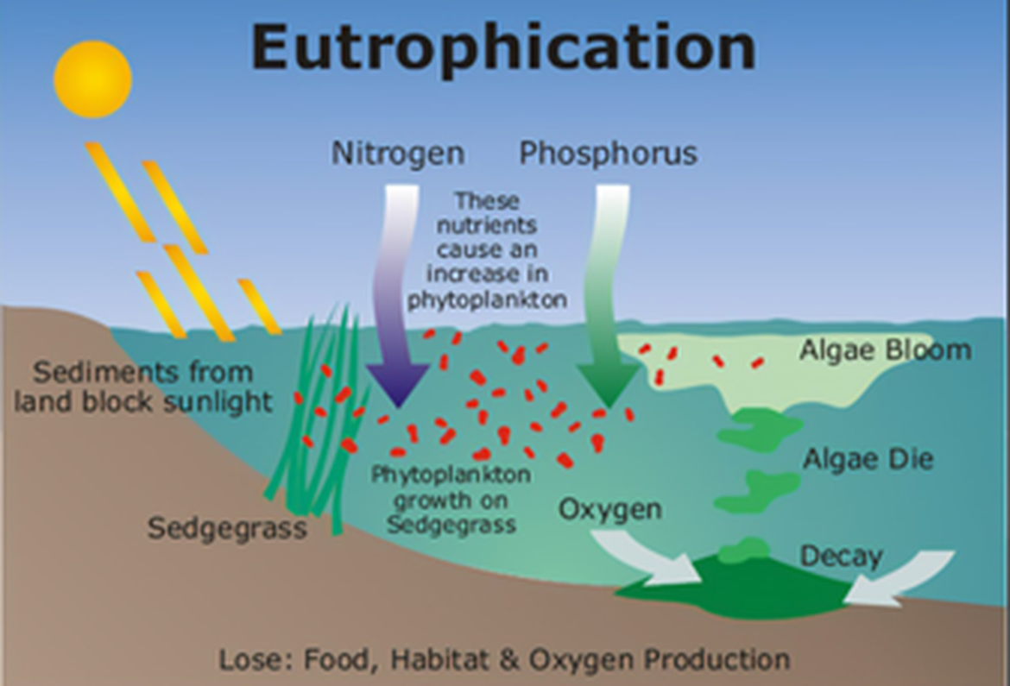
Question 2
How does increased agricultural runoff most directly affect dissolved oxygen levels in a freshwater lake?
A. Dissolved oxygen increases due to nutrient input
B. Dissolved oxygen decreases due to eutrophication
C. Dissolved oxygen remains unchanged
D. Dissolved oxygen increases due to photosynthesis

Slide 11
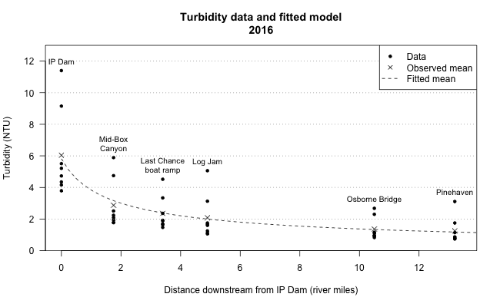
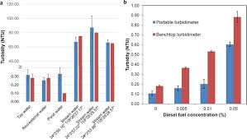
Question 3
The graph shows turbidity levels at four sampling sites along a river.
Which site is most likely located downstream of a construction zone?

Slide 12
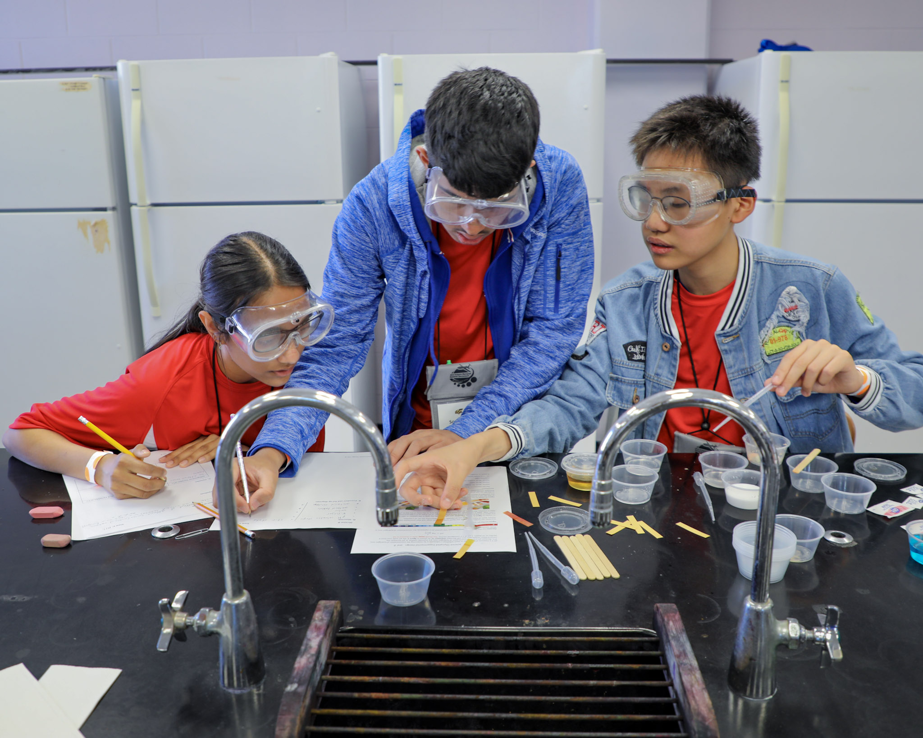
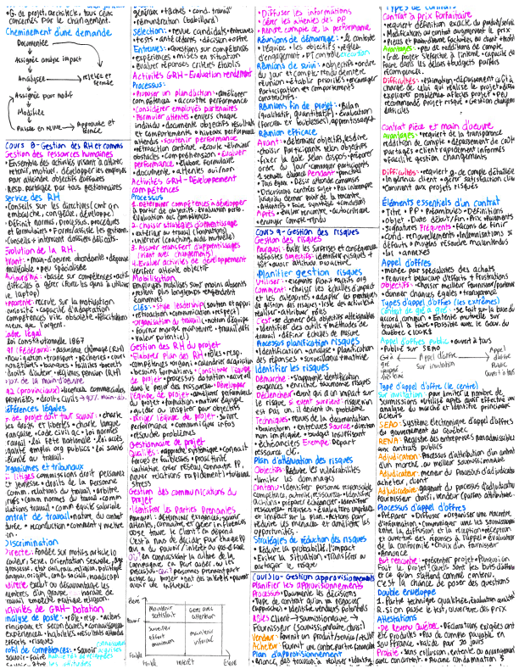


Tips from a Veteran
Know the rules better than anyone
Organize your cheat sheet strategically
Practice interpretation, not just memorization
Divide responsibilities with your partner
Don’t ignore the salinometer

Slide 13
Additional Resources
Science Olympiad Wiki
USGS Water Science School
SUBWAY STATIONS
EPA Water Quality Resources
Past Invitational & State Exams
Yes, Saturn is the ringed one. This planet is a gas giant, and it’s composed mostly of hydrogen and helium

Slide 14
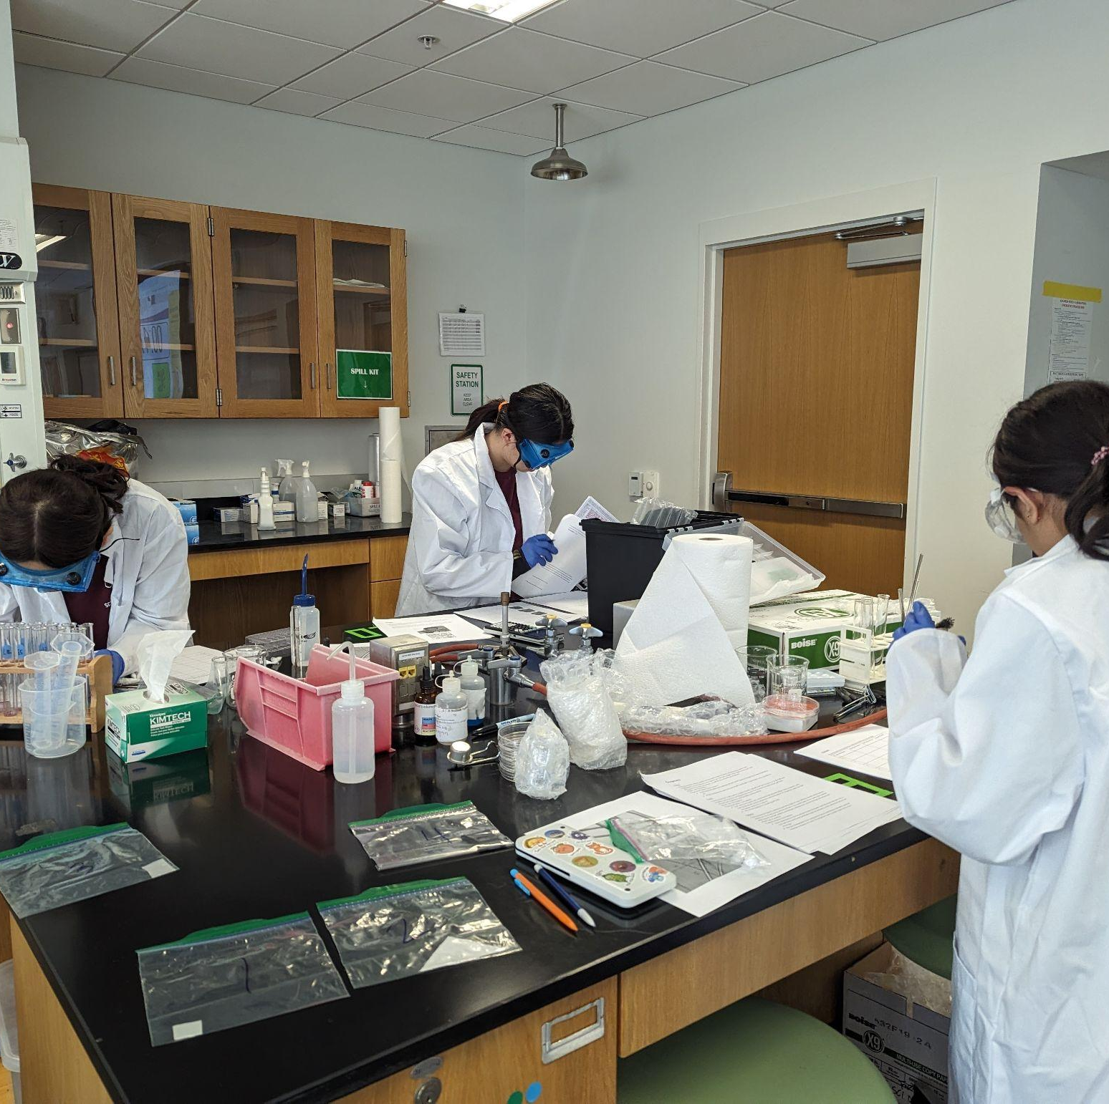
THANKS!

